Slide 1
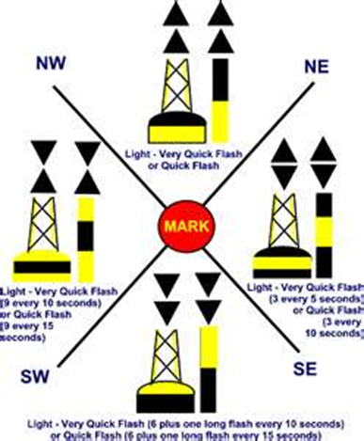
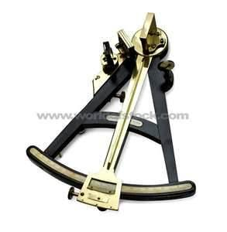
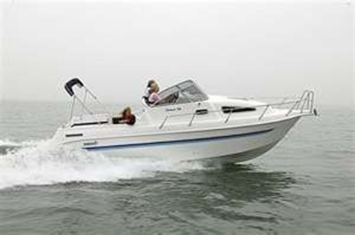
GPS Case Study
Plot Waypoints and Routes

Slide 2
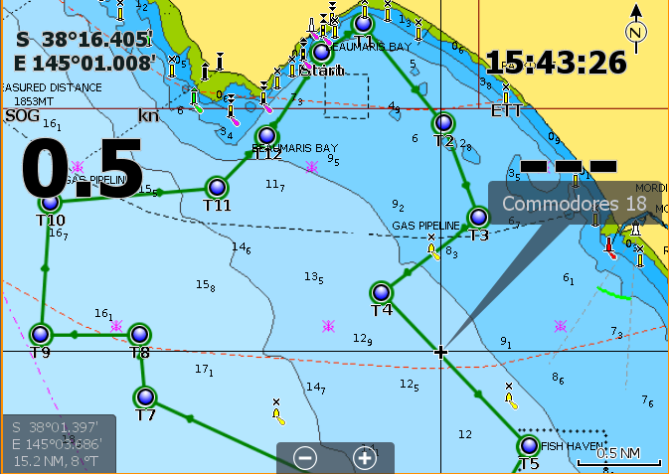
GPS – Waypoints and Routes
Navigation Route for the Nav Rally Course.
Route is a series of connected waypoints.
Create waypoints for Start, Turns and Finish
Add series of waypoints to route
View route on Chart
Navigate the route for Nav Rally Course

Slide 3
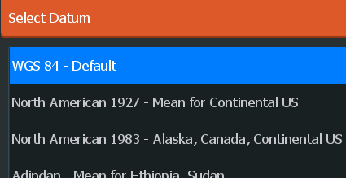
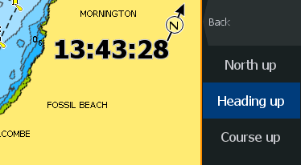
GPS – Settings and Units - 1
Set GPS or Chartplotter units
Nautical miles for distance
Knots for speed
Bearing True (not Magnetic)
Datum to be WGS84
Same for handheld GPS to high end chart plotter

Slide 4
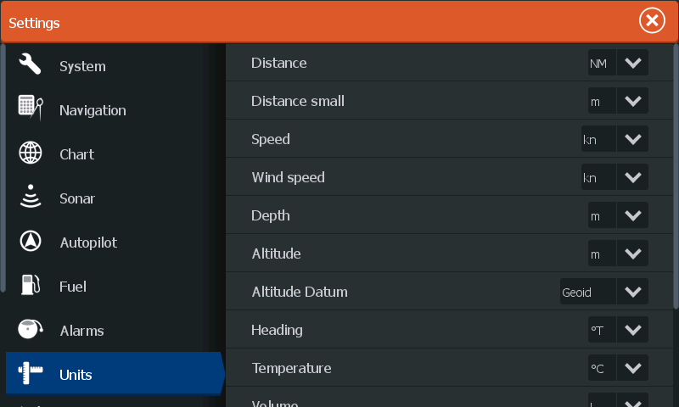
GPS – Settings and Units - 2
Set GPS or Chartplotter units
Nautical miles for distance
Knots for speed
Bearing True (not Magnetic)
Datum to be WGS84
Same for handheld GPS to high end chart plotter

Slide 5
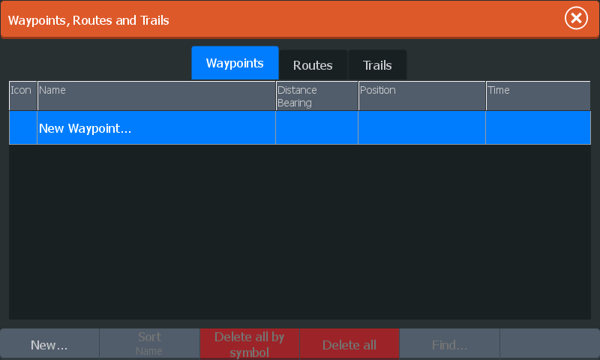
GPS – Create Waypoints 1
Calculate Nav Rally waypoint coordinates for turns
Enter Waypoints in GPS
New waypoint menu shown

Slide 6
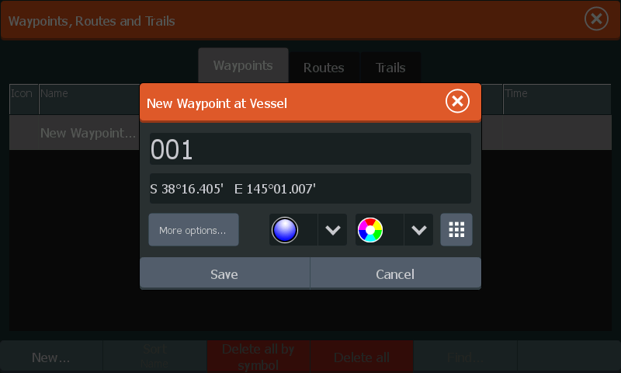
GPS – Create Waypoints 2
Calculate Nav Rally waypoint coordinates for turns
Enter Waypoints in GPS
New waypoint shown

Slide 7
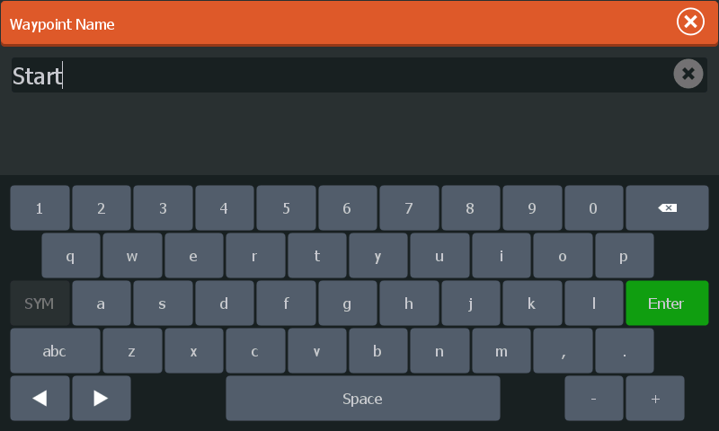
GPS – Create Waypoints 3
Calculate Nav Rally waypoint coordinates
Enter Waypoints in GPS
Waypoints name shown

Slide 8
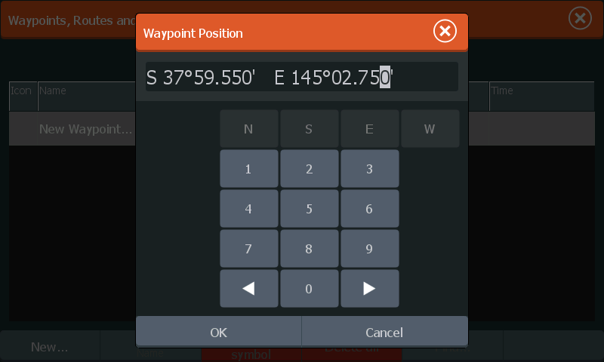
GPS – Create Waypoints 4
Calculate Nav Rally waypoint coordinates for turns
Enter Waypoints in GPS
New waypoint menu shown

Slide 9
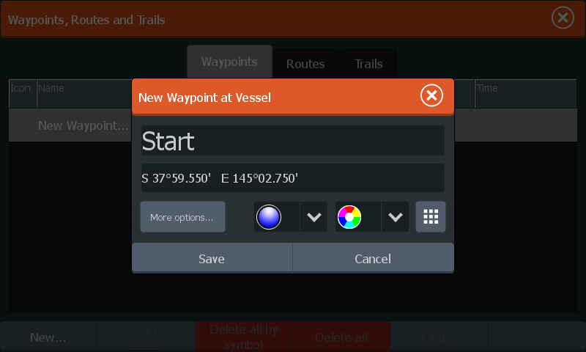
GPS – Create Waypoints 5
Calculate Nav Rally waypoint coordinates for turns
Enter Waypoints in GPS
New waypoint menu shown

Slide 10
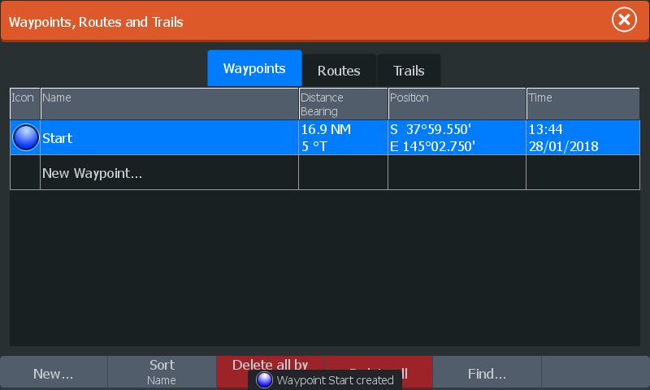
GPS – Create Waypoints 6
Calculate Nav Rally waypoint coordinates
Enter Waypoints in GPS
Create a waypoint for each Turn on the course

Slide 11
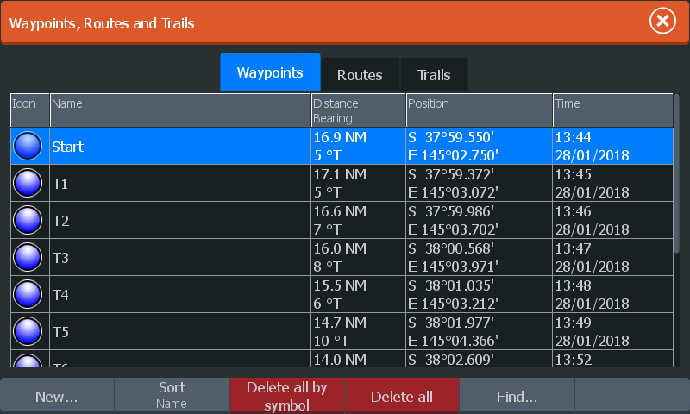
GPS – Create Waypoints 7
Calculate Nav Rally waypoint coordinates
Enter Waypoints in GPS
Create a waypoint for each Turn on the course

Slide 12
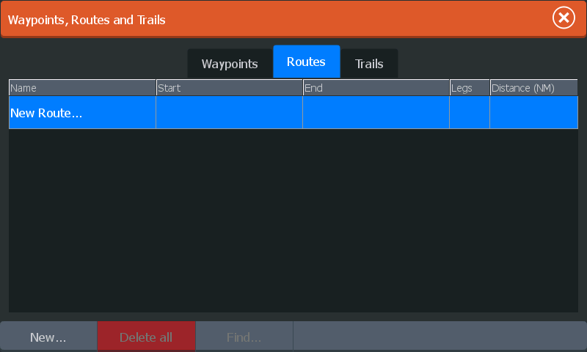
GPS – Create Route for Course
Calculate nav rally waypoint coordinates
Enter Waypoints in GPS
Create a Route for the Nav Rally course

Slide 13
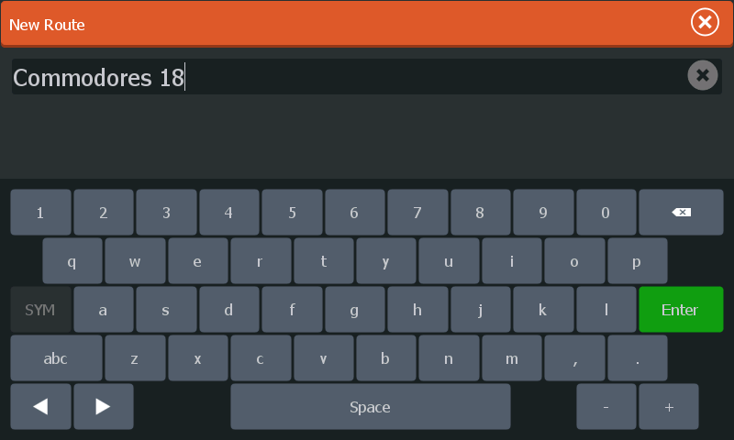
GPS – Edit Route Name
Calculate nav rally waypoint coordinates
Enter Waypoints in GPS
Create Route – Enter Name

Slide 14
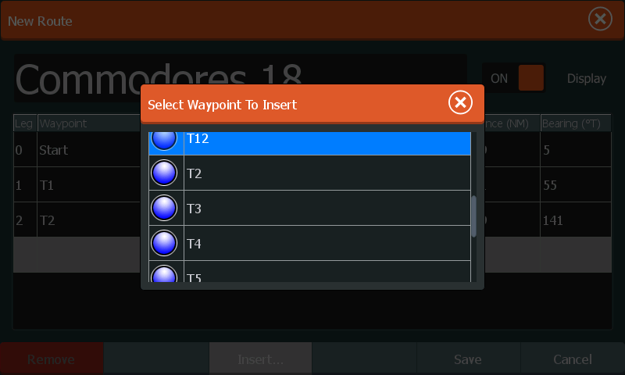
GPS – Route Add Waypoint
Calculate nav rally waypoint coordinates
Enter Waypoints in GPS
Pick waypoint from list in GPS

Slide 15
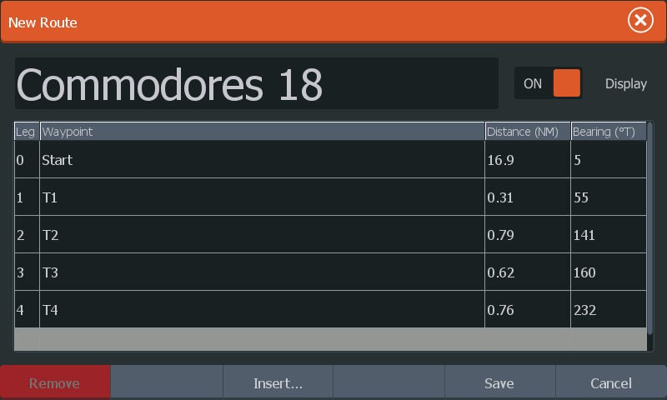
GPS – Route Add Waypoints for Turns
Calculate nav rally waypoint coordinates
Enter Waypoints in GPS and create Route for course
Add all Turn and Finish waypoints

Slide 16
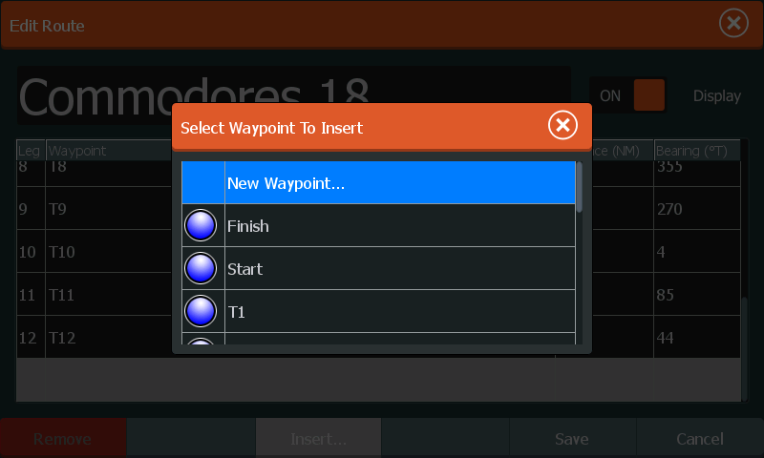
GPS – Route - Waypoints for All Turns
Calculate nav rally waypoint coordinates
Enter Waypoints in GPS
Add Start, Finish and Turn waypoints to route

Slide 17
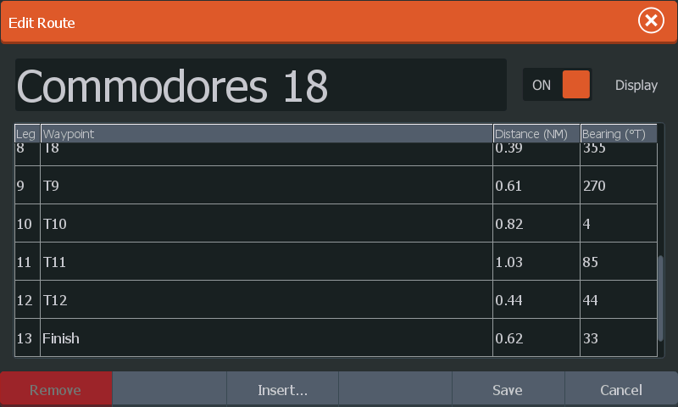
GPS – Route - Waypoints for All Turns
Calculate nav rally waypoint coordinates
Enter Waypoints in GPS
Add Start, Finish and Turn waypoints to route
You can insert intermediate waypoints in between the turns

Slide 18
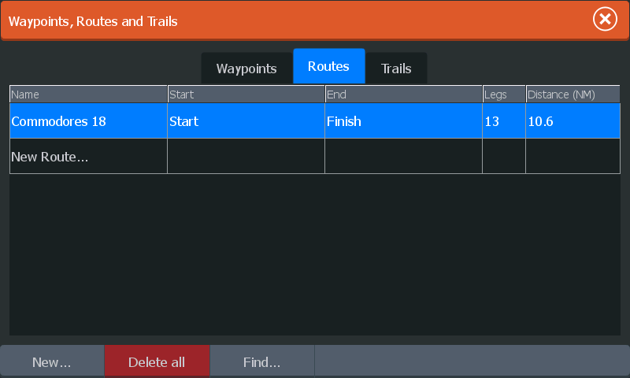
GPS – Route - Waypoints for All Turns
Calculate nav rally waypoint coordinates
Enter Waypoints in GPS
Add Start, Finish and Turn waypoints to route
NavRally - Navigate Route using GPS

Slide 19
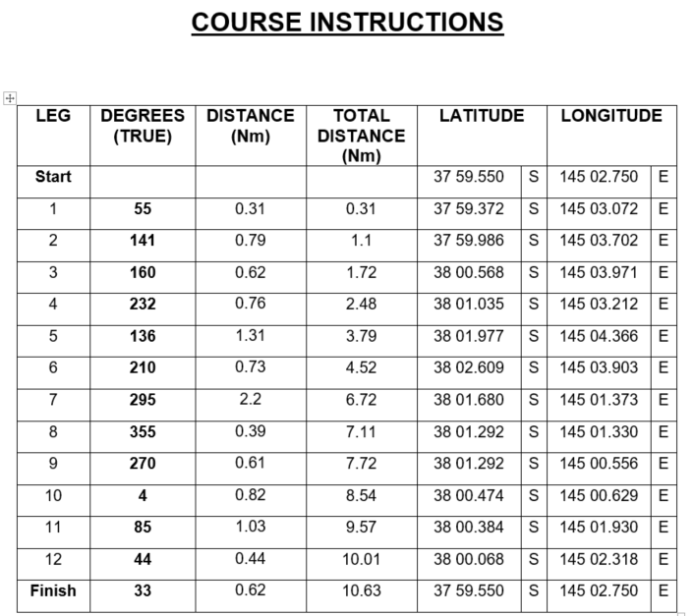
NavRally – Course -> Waypoints / Route -> NavRally
Navigation Route for the Nav Rally Course.
Route is a series of connected waypoints.
Create waypoints for Start, Turns and Finish
Add series of waypoints to route
View route on Chart
Navigate the route for Nav Rally Course

Slide 20
Plotting the Course – Easy GPS -> GPX File
Navigation Route for the Nav Rally Course.
Route is a series of connected waypoints.
Each waypoint has a name and Latitude Longitude coordinates.
When running course need to be at each point at target time
Easy GPS freeware in example
-->
Save course as GPX file
isle of mordy 2017.gpx
NEVER write to map card !

Slide 21
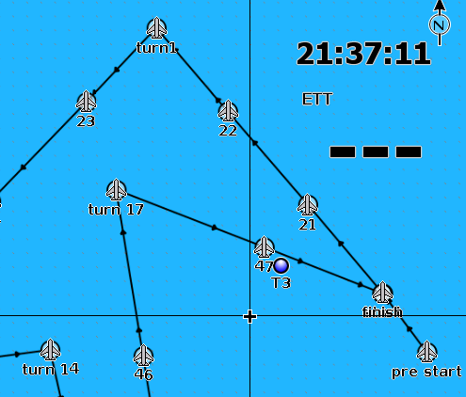
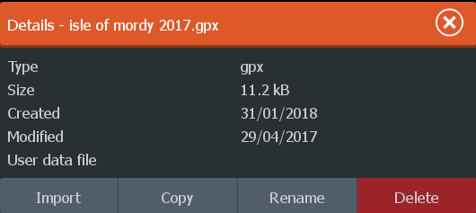
Plotting the Course – Transfer GPX to GPS
-->
-->
Import GPX file
Creates waypoints and course
Do all the work on laptop in the lounge room

Slide 22
Nav Rally Questions

Slide 23
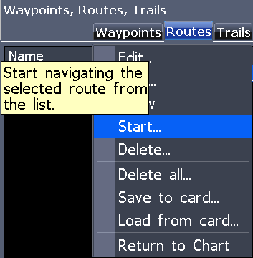
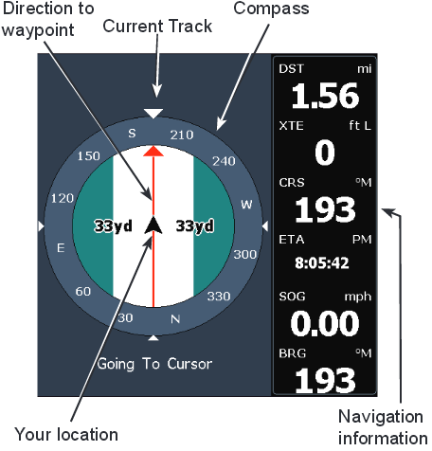
Navigate Route on GPS / Chart
Calculate nav rally waypoint coordinates
Enter Waypoints in GPS and create Route
Menu to start navigation
Vessel position shown on GPS or chart for all device types

Slide 24
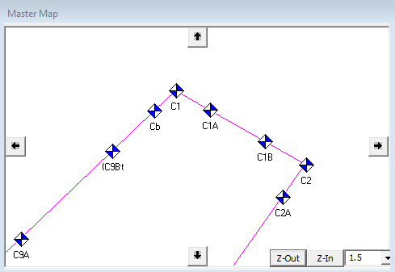
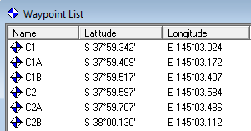
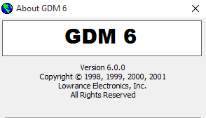
Plotting the Course – GDM6
Lowrance GDM6 – plot waypoints and routes
=>
Course Instructions becomes Navigation Route

Slide 25
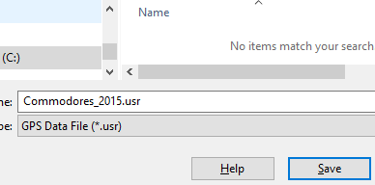
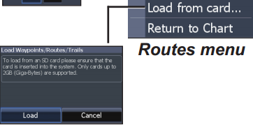
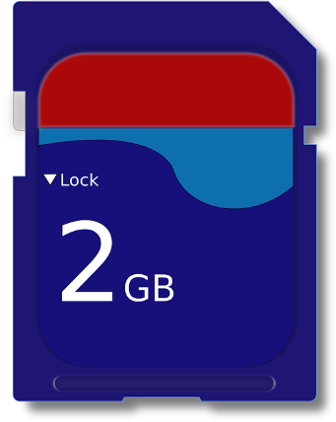
Plotting the Course – Transfer to Chart
Lowrance GDM6 – Save to SD Card
Caution – do NOT write to SD Map

